Slide 1
CSC 362: System Programming
Introduction to C
Original slides by: Amitabha Dey
Adapted by: Dr. Richard Johnson
Department of Computer Science University of North Carolina at Greensboro

Slide 2

Status Check
Install Microsoft VScode
Setup your programming environment
Setup your GitHub
What we will cover today
Run C/C++ code in VScode
Crash Course in C
preprocessor directives
control structures
language facilities
Notes:
Students should have installed Microsoft VS Code.
The programming environment and GitHub should be set up.
Running C/C++ code in VS Code.
A "Crash Course" in C covering preprocessor directives, control structures, and language facilities.

Slide 3
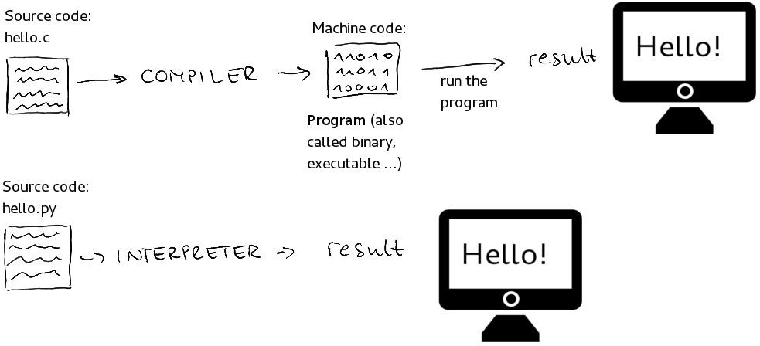
Compiled vs Interpreted Language
Image credit - https://medium.com/from-the-scratch
Notes:
A comparison table of Compiled versus Interpreted languages.
Compiled pros include being "ready to run" and "often faster,"
while cons include not being "cross platform".
Interpreted pros include being "cross-platform" and "easier to debug,"
while cons include being "often slower" and requiring an interpreter.

Slide 4
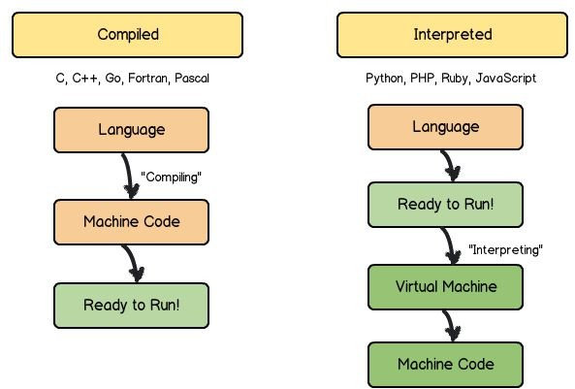
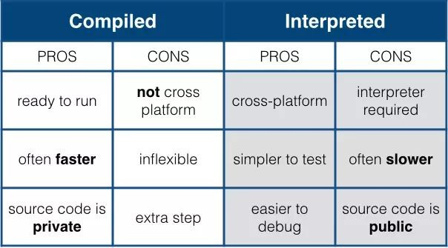
Compiled vs Interpreted Language (2)
Image credit - https://learntocodewith.me/
Image credit - Manuel Grullon @ Medium
Compiled C, C++, Objective C
Interpreted PHP, JavaScript
Hybrid Java, C#, VB.NET, Python

Slide 5
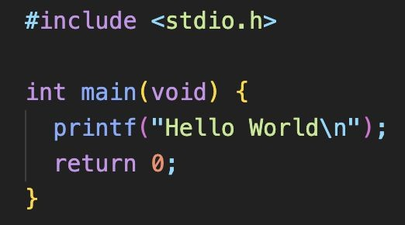
Crash course introduction to C
Preprocessor directive
The #include directive takes the file stdio.h (which stands for standard input and output) located somewhere in your operating system, copies the text, and substitutes it where the #include was.
The hello world program
Notes:
Preprocessor Directive
The #include directive takes a file (like stdio.h for standard input/output) and substitutes its full text into the program where the directive is placed.

Slide 6
Crash course introduction to C
void - no arguments
The int main(void) is a function declaration.
In C, no two functions can have the same name in a single compiled program, although shared libraries may be able.
void specifies that the main function takes no arguments. The void keyword in the parentheses indicates that main does not accept any parameters.
The hello world program
Notes:
Function Declaration
int main(void) declares the main function.
In C, function names must be unique within a single compiled program.
The keyword void in parentheses indicates the function accepts no arguments.

Slide 7
Crash course introduction to C
printf("Hello World") is a function call.
printf is defined as a part of stdio.h. The function has been compiled and lives somewhere else on our machine - the location of the C standard library.
The hello world program
Notes:
Standard Library Functions
printf("Hello World") is a function call.
printf is defined in stdio.h and resides in the C standard library on the machine.

Slide 8
Crash course introduction to C (cont.)
return 0. main has to return an integer. By convention, return 0 means success and anything else means failure.
In general, assume 0 means success.
The hello world program
Notes:
Return Values
main must return an integer.
Conventionally, return 0 signifies success, while any non-zero value signifies failure.

Slide 9
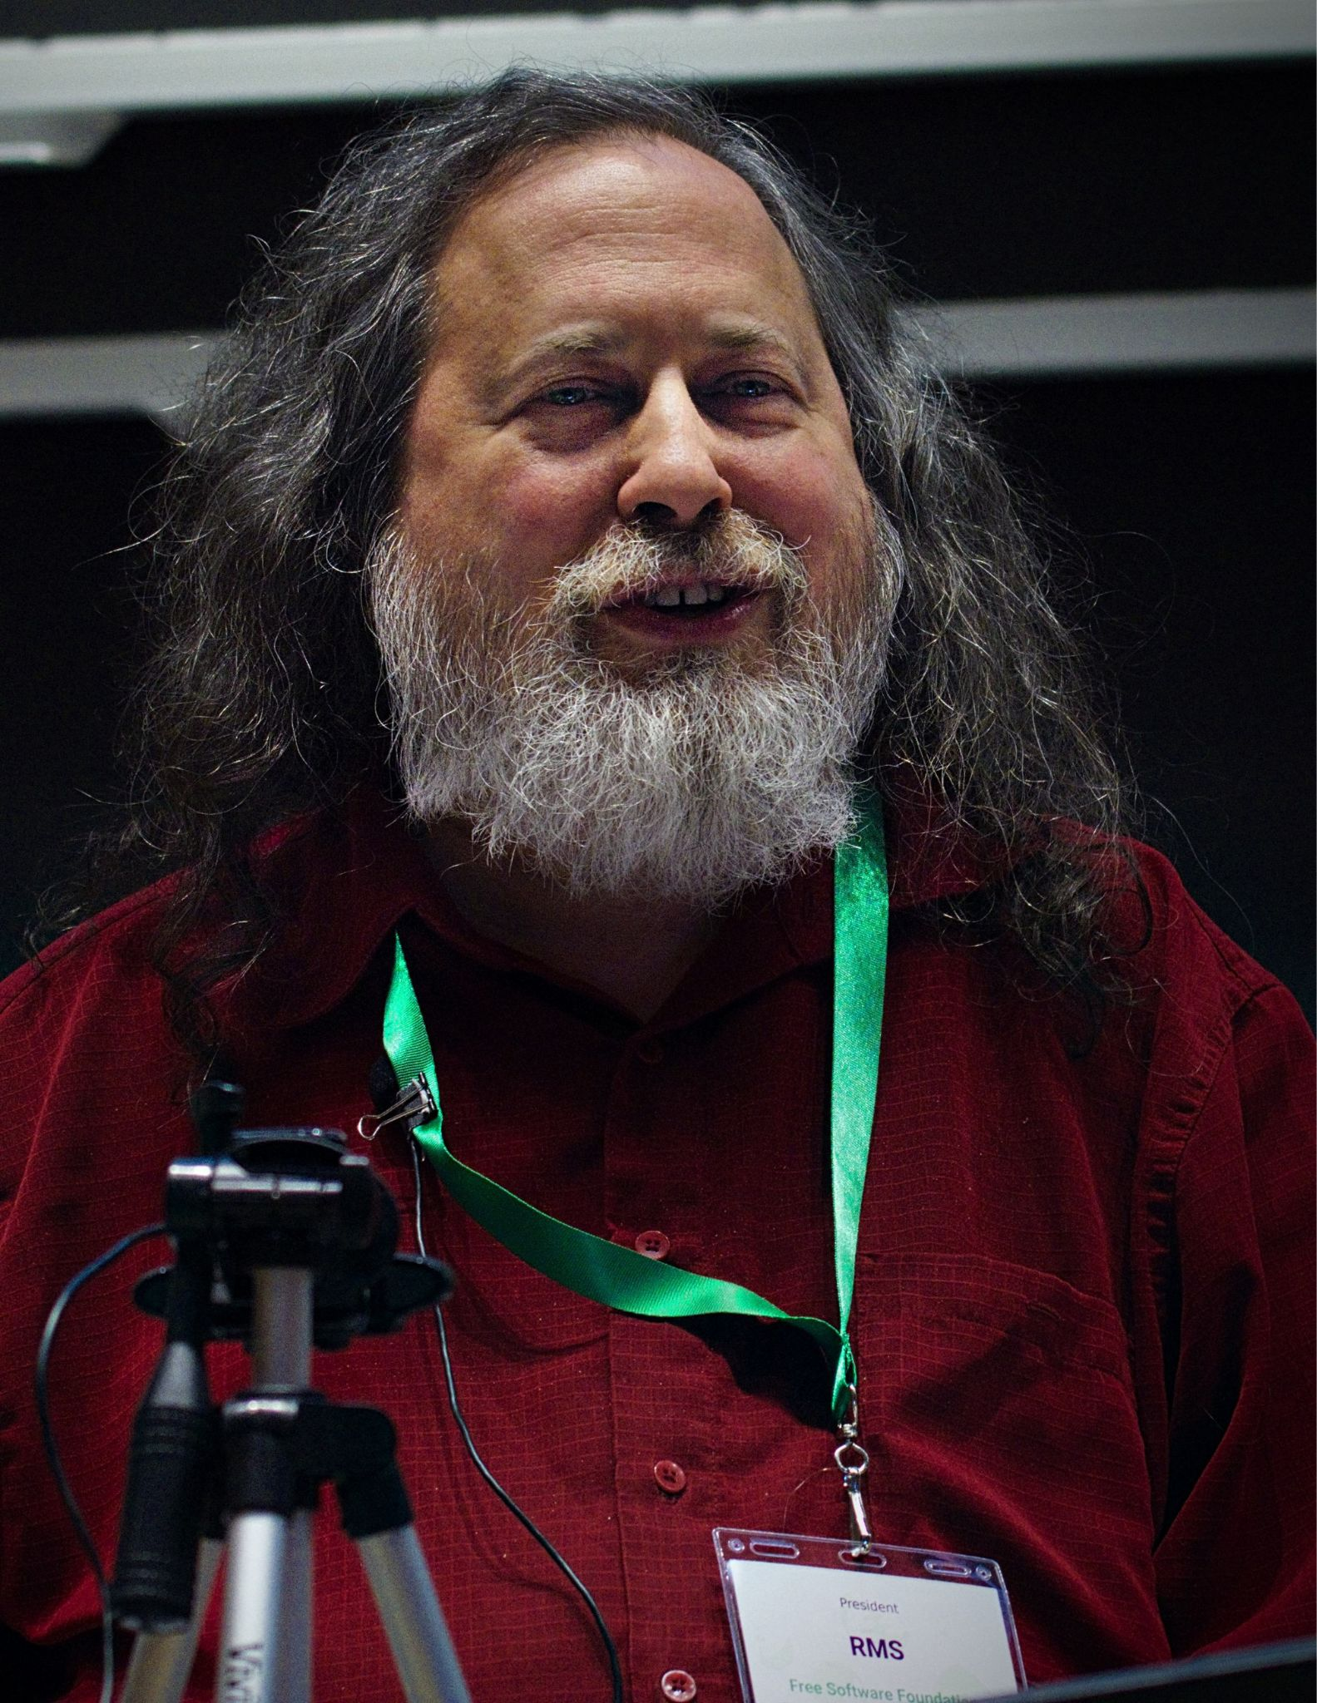
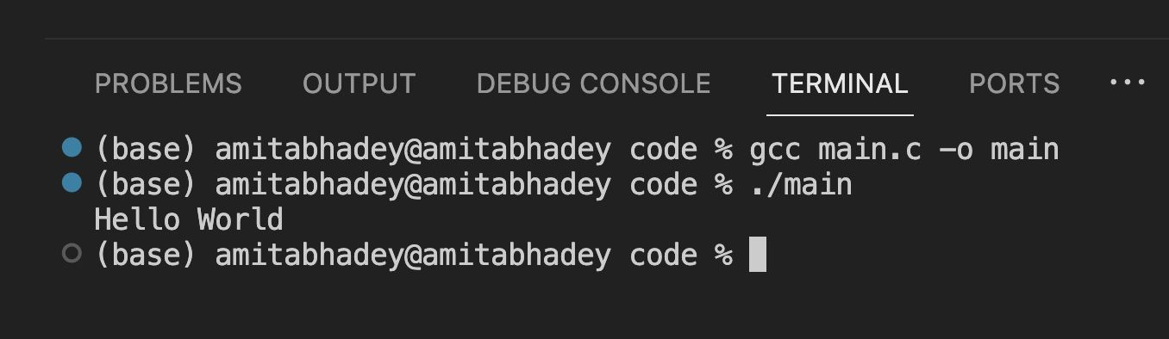

Crash course introduction to C
Compiler - GCC and Clang
gcc is short for the GNU Compiler Collection which has a host of compilers ready for use. The compiler infers from the extension that you are trying to compile a .c file.
Richard Stallman,
creator of GNU Compiler Collection
Chris Lattner,
creator of LLVM (Clang)
Notes:
Compilers
Common compilers include GCC (GNU Compiler Collection) and Clang (LLVM).
The compiler uses file extensions (like .c) to infer the source type.

Slide 10
Crash course introduction to C
GCC compiler
main.c: This is the source file that you want to compile.
-o: This option is used to specify the output file name for the executable. In this case, it is followed by main, indicating that the compiled program should be named main. You can replace main with the desired name for your executable.
Notes:
GCC Compiler Options
Command example: gcc main.c -o main.
-o specifies the output executable name.
If a name for the binary is not specified, the binary will be a.out

Slide 11
Crash course introduction to C
GCC compiler (cont.)
./main tells your shell to execute the program in the current directory called main. The program then prints out “hello world”.
Notes:
Execution
Use ./main in the shell to execute the program in the current directory.

Slide 12
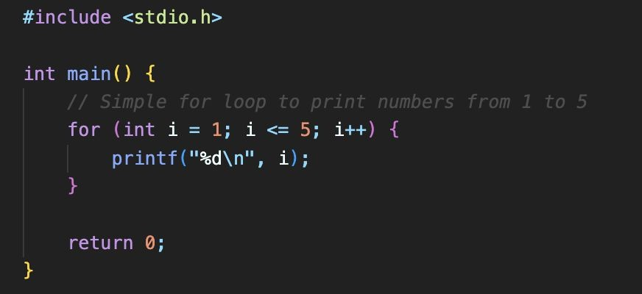
Crash course introduction to C Control Structures: for loop
for is a keyword that allows you to iterate with an initialization condition, a loop invariant, and an update condition. This is meant to be equivalent to a while loop, but with differing syntax.
Notes:
for loop
Uses an initialization condition, a loop invariant, and an update condition.
It is syntactically different but logically equivalent to a while loop.

Slide 13
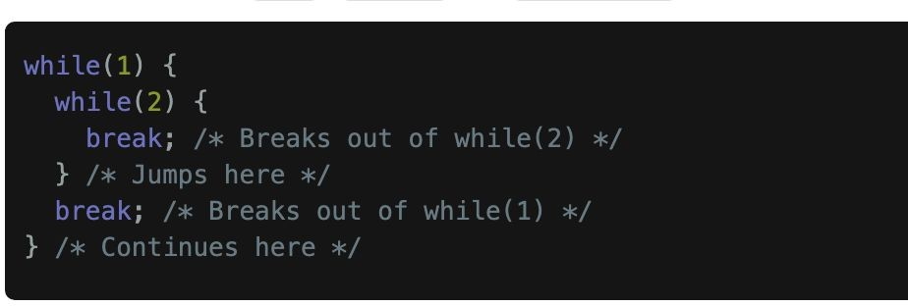
Crash course introduction to C
Control Structures: while loop and break
In the context of a loop, using it breaks out of the inner-most loop. The loop can be either a for, while, or do-while construct
Notes:
while loop and break
break is used to exit the innermost loop (for, while, or do-while).

Slide 14
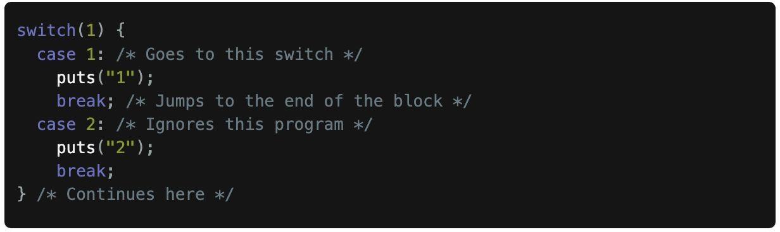
Crash course introduction to C
Control Structures: switch case
break is a keyword that is used in case statements or looping statements. When used in a case statement, the program jumps to the end of the block.
Notes:
switch case
break in a switch statement causes the program to jump to the end of the block.

Slide 15
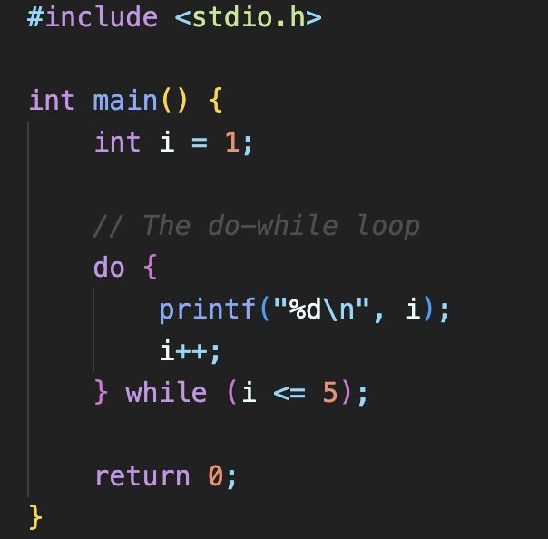
Crash course introduction to C
Control Structures: do-while loop
do {} while(); is another loop construct. These loops execute the body and then check the condition at the bottom of the loop. If the condition is zero, the next statement is executed – the program counter is set to the first instruction after the loop. Otherwise, the loop body is executed.
Notes:
do-while loop
Executes the body first, then checks the condition at the bottom.
If the condition is zero (false), it exits to the next statement.

Slide 16
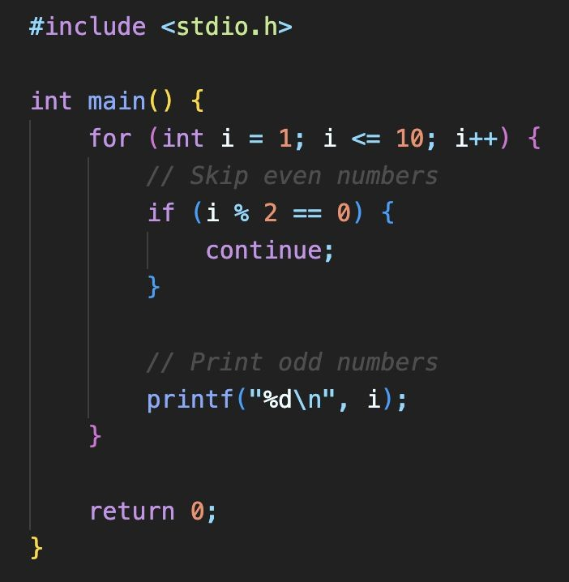
Crash course introduction to C
Language Facilities: continue
continue is a control flow statement that exists only in loop constructions. Continue will skip the rest of the loop body and set the program counter back to the start of the loop before.
Notes:
continue
Skips the rest of the current loop body and returns to the start of the loop.

Slide 17
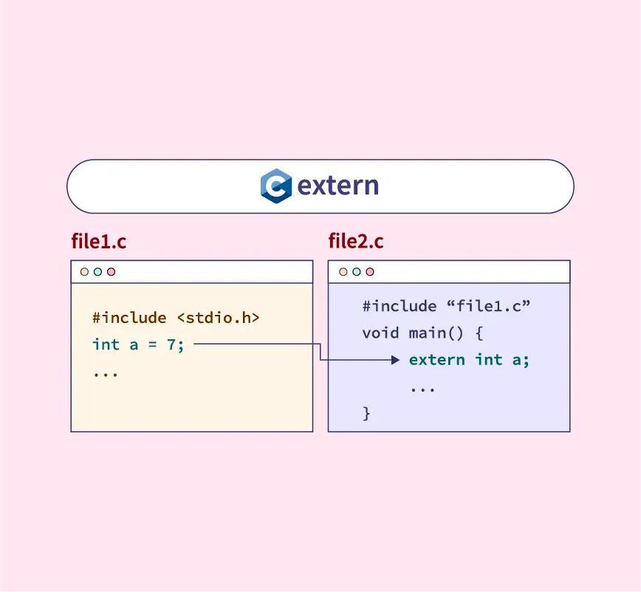
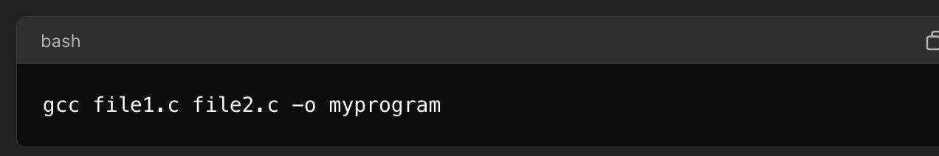
Crash course introduction to C
extern
extern is a special keyword that tells the compiler that the variable may be defined in another object file or a library, so the program compiles on missing variable because the program will reference a variable in the system or another file.
Image credit - https://www.scaler.com/
Notes:
extern
Tells the compiler a variable may be defined in another file or library, allowing compilation even if the variable isn't in the current file.

Slide 18
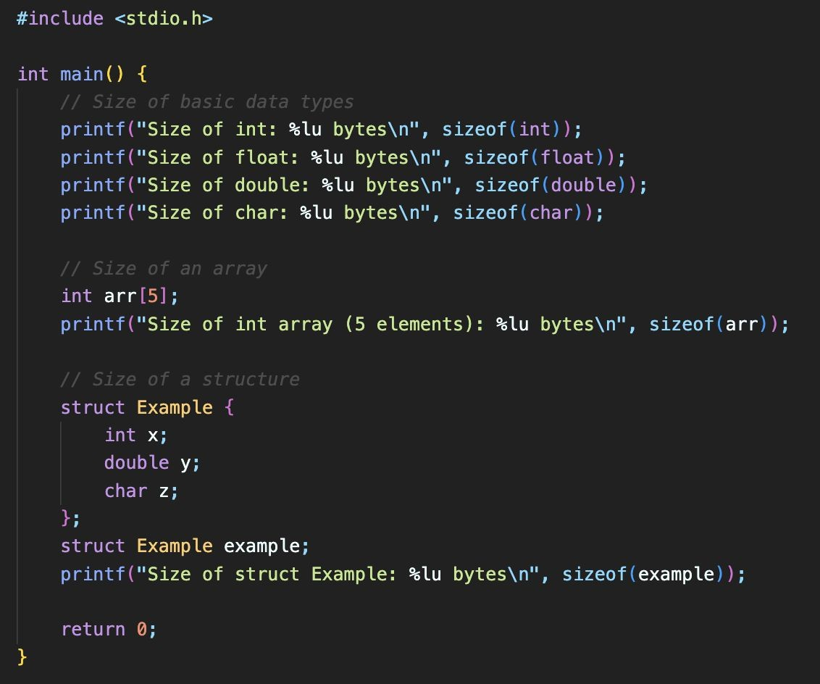
Crash course introduction to C Language Facilities: size of
sizeof is an operator that is evaluated at compile-time, which evaluates to the number of bytes that the expression contains.
The sizeof operator in C is used to determine the size, in bytes, of a type or an object.
Notes:
sizeof
An operator evaluated at compile-time that returns the size (in bytes) of a type or object.

Slide 19
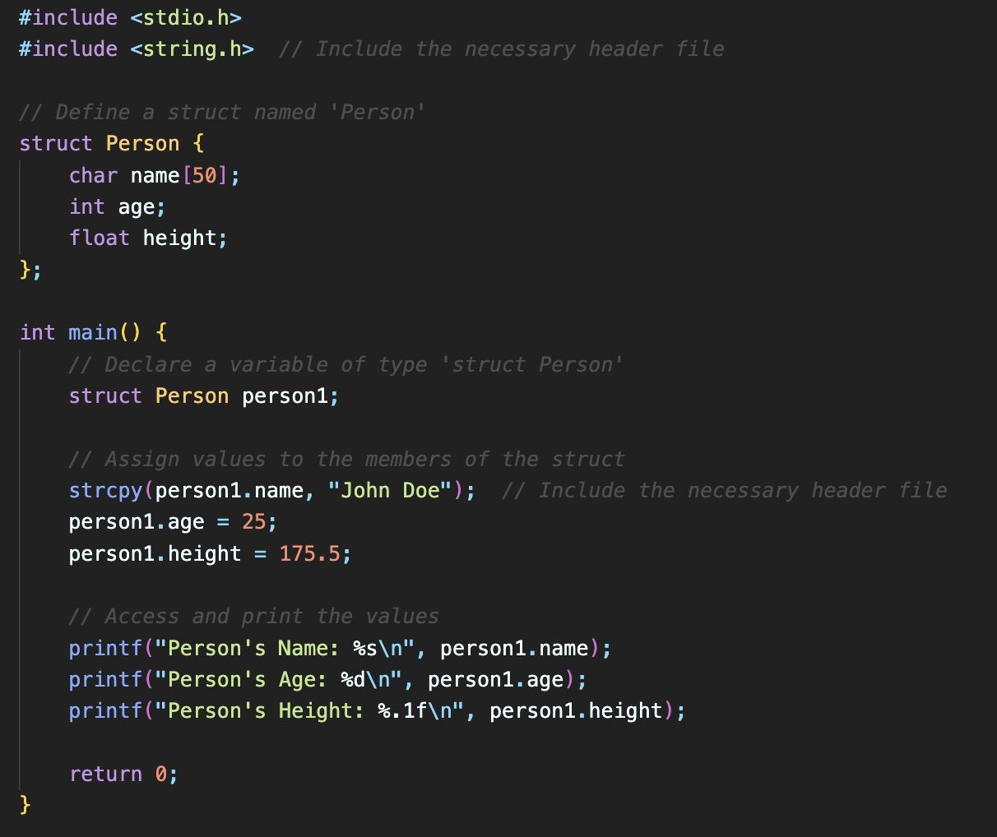
Crash course introduction to C Language Facilities: struct
struct is a keyword that allows you to pair multiple types together into a new structure. C-structs are contiguous regions of memory that one can access specific elements of each memory as if they were separate variables.
Structs are useful for grouping related data together and can be used to represent more complex data structures.
Notes:
struct
Pairs multiple types into a new structure stored in contiguous memory.

Slide 20
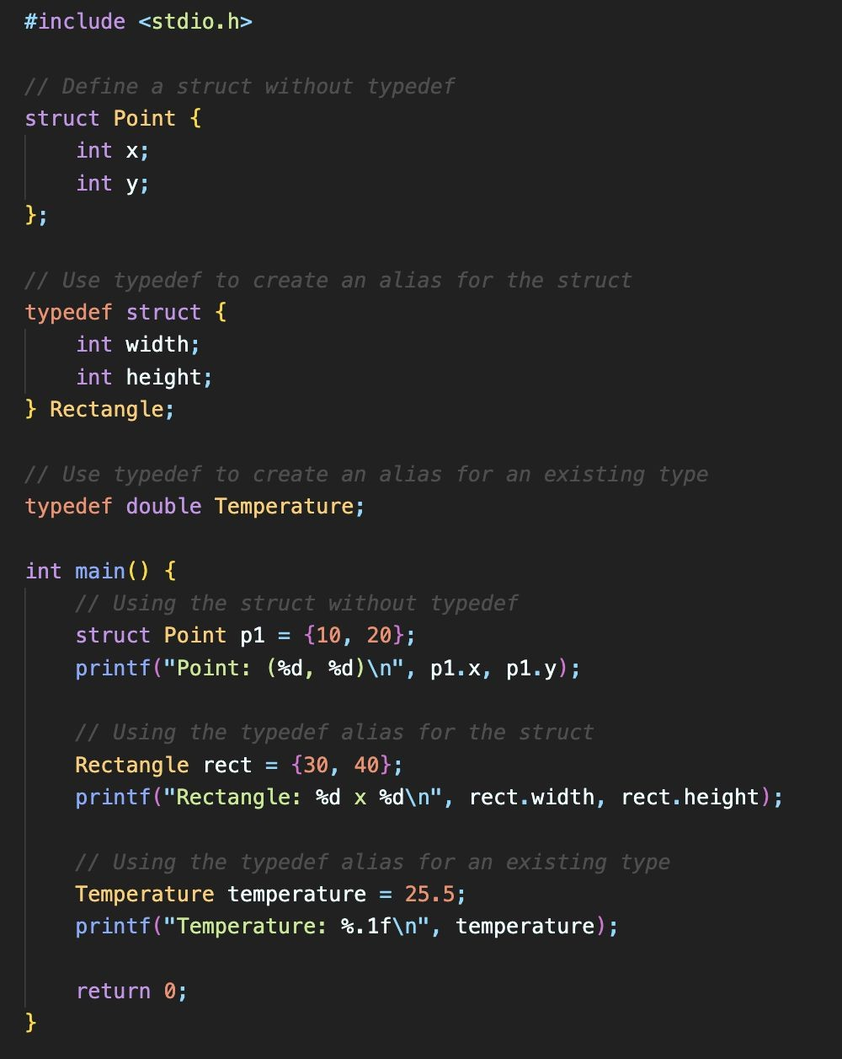
Crash course introduction to C Language Facilities: typedef
typedef declares an alias for a type. It is like giving a nickname to a data type.
It allows you to create a new name for an existing type or define a shorter name for a complex type. This can make your code more readable and easier to understand.
Often used with structs to reduce the visual clutter of having to write ‘struct’ as part of the type.
Notes:
typedef
Creates an alias or "nickname" for an existing type to improve readability.
Commonly used with struct to reduce visual clutter.
Pro-Tip
The typedef keyword is a favorite among C programmers because it reduces "syntactic noise."
Instead of having to type struct Rectangle rect; every time you want a new variable, you can simply type Rectangle rect;.
It makes your code much cleaner and easier to read!

Slide 21
Crash course introduction to C C data types (1-3)
char Represents exactly one byte of data. The number of bits in a byte might vary. unsigned char and signed char are always the same size, which is true for the unsigned and signed versions of all data types. This must be aligned on a boundary (meaning you cannot use bits in between two addresses). The rest of the types will assume 8 bits in a byte.
short (short int) must be at least two bytes. This is aligned on a two-byte boundary, meaning that the address must be divisible by two.
int must be at least two bytes. Again, aligned to a two-byte boundary ("ISO C Standard" #ref-ISON1124 P. 34). On most machines this will be 4 bytes.
Notes:
char: Exactly one byte.
short: At least two bytes
int: Usually 4 bytes on modern machines.

Slide 22
Crash course introduction to C C data types (4-7)
long (long int) must be at least four bytes, which are aligned to a four-byte boundary. On some machines this can be 8 bytes.
long long must be at least eight bytes, aligned to an eight-byte boundary.
float represents an IEEE-754 single precision floating point number tightly specified by IEEE ("IEEE Standard for Floating-Point Arithmetic" #ref-4610935). This will be four bytes aligned to a four-byte boundary on most machines.
double represents an IEEE-754 double precision floating point number specified by the same standard, which is aligned to the nearest eight-byte boundary.
Notes:
long: At least 4 bytes; long long: At least 8 bytes.
float / double: IEEE-754 floating-point numbers.

Slide 23
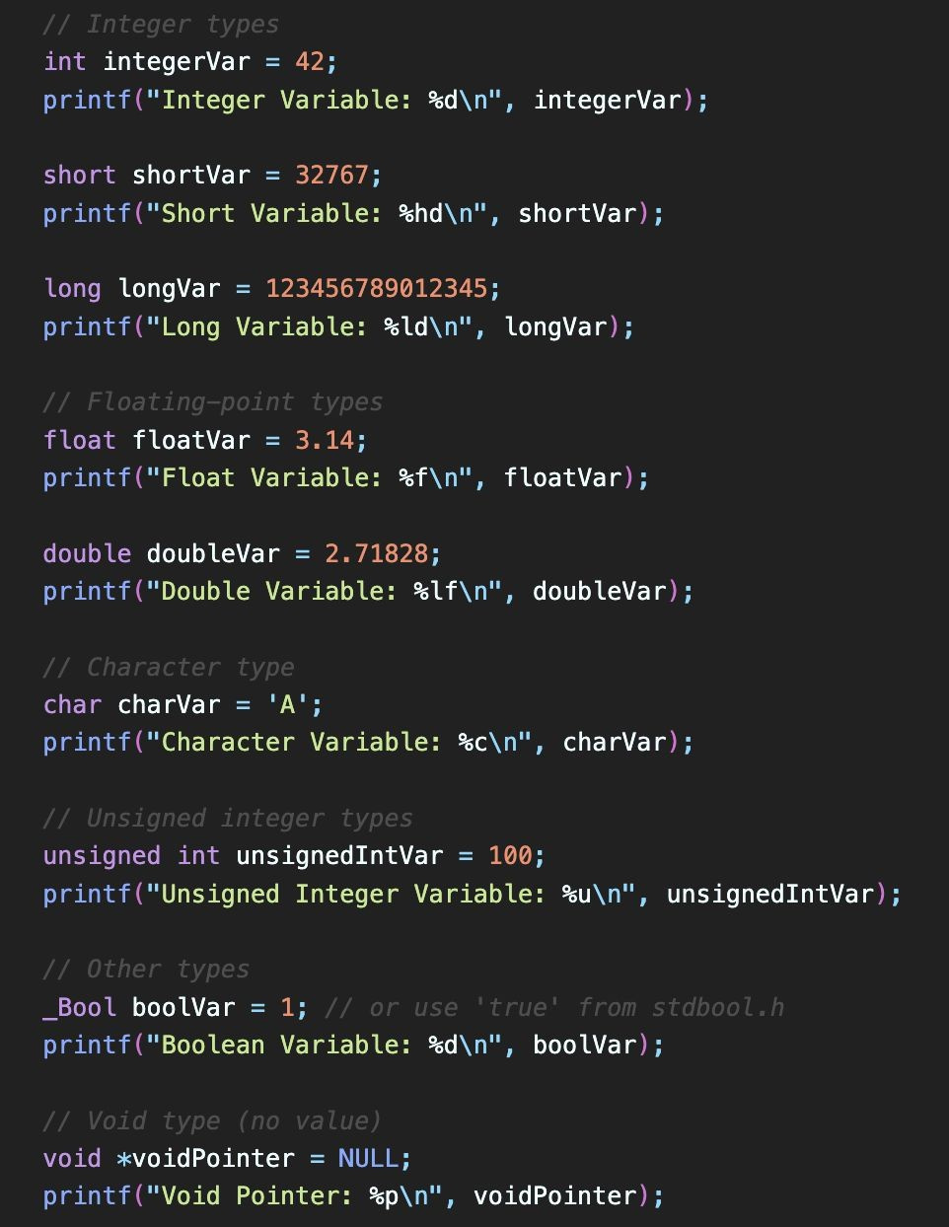
Crash course introduction to C
C data types (cont.)
Integer types include int, short, and long.
Floating-point types include float and double.
Character type is char.
Unsigned integer type is unsigned int.
Boolean type is _Bool (true or false).
Void type represents the absence of a value.
Notes:
…
_Bool: Boolean type (true/false).
…

Slide 24
Crash course introduction to C C operators (1)
[] is the subscript operator. a[n] == *(a + n) where n is a number type and a is a pointer type.
-> is the structure dereference (or arrow) operator. If you have a pointer to a struct *p, you can use this to access one of its elements: p->element.
. is the structure reference operator. If you have an object a then you can access an element a.element.
+/-a is the unary plus and minus operator. They either keep or negate the sign, respectively, of the integer or float type underneath.
Notes:
Subscripting:
a[n] is equivalent to *(a + n).
Struct Access:
-> for pointers to structs;
. for direct object access.

Slide 25
Crash course introduction to C C operators (2)
*a is the dereference operator. If you have a pointer *p, you can use this to access the element located at this memory address. If you are reading, the return value will be the size of the underlying type. If you are writing, the value will be written with an offset.
&a is the address-of operator. This takes an element and returns its address.
++ is the increment operator. You can use it as a prefix or postfix, meaning that the variable that is being incremented can either be before or after the operator. a = 0; ++a === 1 and a = 1; a++ === 0.
Notes:
Pointers:
*a dereferences a pointer;
&a gets the address of a variable.
Increment/Decrement:
++ and -- can be prefix or postfix.

Slide 26
Crash course introduction to C C operators (3)
-- is the decrement operator. This has the same semantics as the increment operator except that it decreases the value of the variable by one.
sizeof is the sizeof operator, that is evaluated at the time of compilation. This is also mentioned in the keywords section.
a <mop> b where <mop> in {+, -, *, %, /} are the arithmetic binary operators. If the operands are both number types, then the operations are plus, minus, times, modulo, and division respectively. If the left operand is a pointer and the right operand is an integer type, then only plus or minus may be used and the rules for pointer arithmetic are invoked.

Slide 27
Crash course introduction to C C operators (4)
>>/<< are the bit shift operators. The operand on the right has to be an integer type whose signedness is ignored unless it is signed negative in which case the behavior is undefined. The operator on the left decides a lot of semantics. If we are left shifting, there will always be zeros introduced on the right. If we are right shifting there are a few different cases:
If the operand on the left is signed, then the integer is sign-extended. This means that if the number has the sign bit set, then any shift right will introduce ones on the left. If the number does not have the sign bit set, any shift right will introduce zeros on the left.
If the operand is unsigned, zeros will be introduced on the left either way.
Notes:
Bit Shifting:
<< (left shift) introduces zeros;
>> (right shift) behavior depends on whether the operand is signed (sign-extended) or unsigned (zero-filled).

